Slide 1
Strengthening Skills
Dr Shruti Verma

Slide 2
Critical thinking skills

Slide 3
What Is Critical Thinking?
Critical thinking is the ability to think in an organized and rational manner in order to understand connections between ideas and/or facts. It helps you decide what to believe in. In other words, it’s “thinking about thinking”—identifying, analyzing, and then fixing flaws in the way we think.

Slide 4
8 critical thinking skills
Analytical thinking: Part of critical thinking is evaluating data from multiple sources in order to come to the best conclusions. Analytical thinking allows people to reject bias and strive to gather and consume information to come to the best conclusion.
Open-mindedness: This critical thinking skill helps you analyze and process information to come to an unbiased conclusion. Part of the critical thinking process is letting your personal biases go and coming to a conclusion based on all of the information.
Problem solving: Because critical thinking emphasizes coming to the best conclusion based on all of the available information, it’s a key part of problem solving. When used correctly, critical thinking helps you solve any problem—from a workplace challenge to difficulties in everyday life.
Self-regulation: Self-regulation refers to the ability to regulate your thoughts and set aside any personal biases to come to the best conclusion. In order to be an effective critical thinker, you need to question the information you have and the decisions you favor—only then can you come to the best conclusion.

Slide 5
8 critical thinking skills
Observation: Observation skills help critical thinkers look for things beyond face value. To be a critical thinker you need to embrace multiple points of view, and you can use observation skills to identify potential problems.
Interpretation: Not all data is made equal—and critical thinkers know this. In addition to gathering information, it’s important to evaluate which information is important and relevant to your situation. That way, you can draw the best conclusions from the data you’ve collected.
Evaluation: When you attempt to answer a hard question, there is rarely an obvious answer. Even though critical thinking emphasizes putting your biases aside, you need to be able to confidently make a decision based on the data you have available.
Communication: Once a decision has been made, you also need to share this decision with other stakeholders. Effective workplace communication includes presenting evidence and supporting your conclusion—especially if there are a variety of different possible solutions.

Slide 6
Why Are Critical Thinking Skills Important?
When you think critically, you’ll constantly challenge what seems given. Say, in your job, even if something appears to be functioning properly, critical thinking will help you try and identify new, better solutions.
Critical thinking skills are the cornerstone of self-development and improvement. That’s why they’re so critical to have in today’s job market.
And critical thinking skills are necessary for us to accept the flaws in our reasoning and gaps in our knowledge, and take advantage of them!

Slide 7
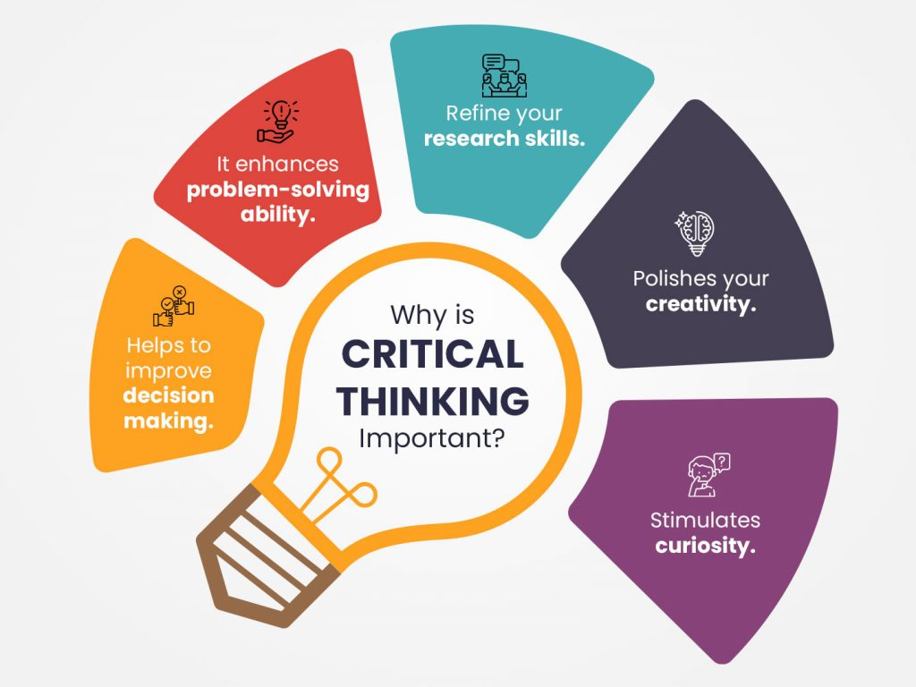

Slide 8
Valuable critical thinking approaches
A company is a sum of the decisions taken by its management and employees. Applying critical thinking in work situations will improve your performance and the company’s chances of succeeding.
1. Promoting a teamwork approach to problem-solving
Any department within a company is a team and effective collaboration is important to its success. When developing a strategy, logically analyze all the team members’ input and offer constructive criticism, while also presenting your own view on the situation.
2. Self-evaluating your contributions to company goals
If your company is trying to reach a target, show critical thinking by evaluating your contribution and discovering ways to improve your performance. For example, you could list all the ways you are contributing and their impact on the overall progress. After doing that, you can think of prioritizing certain current activities, but also adding new ones that you think will help.
3. Practicing self-reflection
Analyzing your own thought process when making certain decisions should help you improve how you process information. This can mean asking yourself why you acted a certain way in a situation or evaluating a decision to find ways you can improve.

Slide 9
Valuable critical thinking approaches
4. Making informed decisions
Through time and effort, you can improve your decision-making process by evaluating all available information. It can be tempting to quickly judge a situation and move on to something else, but applying critical thinking will usually result in a more satisfactory outcome. Consider preparing lists of pros and cons, either mentally or on paper, and critically evaluate things from someone else’s perspective.
5. Using your time wisely
Deciding how you use your time is another example of critical thinking. Continually evaluating how you spend your time can help you discover tasks and activities that may change how you prioritize your duties. For example, if you’re allocating a lot of time to an activity that has a low return, such as administrative tasks or internal reporting, you might consider re-prioritizing your schedule to spend more time on high-return tasks.

Slide 10
Creative problem-solving skills

Slide 11
What is Critical Problem Solving?
Problem solving refers to the ability to use knowledge, facts, and data to effectively solve problems. This doesn’t mean you need to have an immediate answer, it means you have to be able to think on your feet, assess problems and find solutions. The ability to develop a well thought out solution within a reasonable time frame, however, is a skill that employers value greatly.

Slide 12
Problem Solving Skill 1- Creativity
Creativity
“Problems are nothing but wake-up calls for creativity.” –Gerhard Gschwandtner
Creativity allows us to examine a problem from multiple perspectives, use outside-the-box thinking, and come up with innovative solutions.
By embracing creativity, we open ourselves up to new possibilities and make our problem-solving efforts more effective.
How to use creativity in the workplace
Create processes to improve workflow and reduce costs.
Brainstorm ideas to develop new products or services for a company.
Develop strategies to increase customer loyalty and satisfaction.
Leverage technology to create more efficient processes and systems.
Analyze data to identify trends and opportunities for improvement.

Slide 13
Problem Solving Skill 2- Research
“Research is formalized curiosity. It is poking and prying with a purpose.” – Zora Neale Hurston
Research skills are essential when resolving complex problems.
Only by gathering and analyzing data from multiple sources can we begin to assess the problem and determine the most appropriate solutions accurately.
How to use research in the workplace
Identify new markets or customer segments to target.
Gather information about competitors and their products/services.
Stay up to date on industry news and developments.
Evaluate potential partners, vendors, or products before purchasing.
Analyze past performance in order to make projections for the future.

Slide 14
Problem Solving Skill 3- Communication
“Good communication is just as stimulating as black coffee, and just as hard to sleep after.” -Anne Morrow Lindbergh
Once you’ve identified a potential solution to a problem, you need to be able to explain it clearly to others.
This involves both verbal and written communication, as well as the ability to listen carefully and understand the perspective of others.
How to communicate in the workplace
Clarify goals and make sure that everyone is on the same page.
Resolve conflicts quickly and efficiently.
Promote collaboration among team members by fostering trust and respect.
Allow employees to exchange feedback regularly.
Provide recognition and appreciation to team members.

Slide 15
Problem Solving Skill 4- Teamwork
“Alone we can do so little; together we can do so much.” – Helen Keller
Being able to work on a team is an important skill that contributes to effective problem-solving.
When team members work together to tackle complex issues, the best solutions are often found because each individual has a unique perspective and skill set that can contribute to solving the problem.
How to be a team player in the workplace
Foster an environment of open communication, feedback, and growth.
Utilize the strengths of individual team members to achieve a common goal.
Develop trust, respect, and camaraderie among team members.
Promote a culture of accountability and ownership for projects.
Encourage creativity, risk-taking, and an atmosphere of experimentation.

Slide 16
Problem Solving Skill 5- Decision Making
“You cannot make progress without making decisions.” – Jim Rohn
It’s important to be able to identify problems and analyze possible solutions. Still, at some point, you need to make a decision.
Good decision-makers focus on solving the problem rather than wasting time analyzing all of the available data or endlessly debating which option is best.
How to make decisions in the workplace
Use feedback constructively to make better decisions in the future.
Take risks when necessary while being aware of the potential consequences.
Learn from mistakes and use data to develop better solutions.
Demonstrate confidence and decisiveness when making difficult choices.
Analyze situations based on facts and data, not assumptions or emotions.

Slide 17
How to use Critical Thinking for problem Solving
1. Identify the problem or question- Be as precise as possible: the narrower the issue, the easier it is to find solutions or answers.
2. Gather data, opinions, and arguments- Try to find several sources that present different ideas and points of view.
3. Analyze and evaluate the data- Are the sources reliable? Are their conclusions data-backed or just argumentative? Is there enough information or data to support given hypotheses?
4. Identify assumptions- Are you sure the sources you found are unbiased? Are you sure you weren’t biased in your search for answers?
5. Establish significance- What piece of information is most important? Is the sample size sufficient? Are all opinions and arguments even relevant to the problem you’re trying to solve?
6. Make a decision/reach a conclusion- Identify various conclusions that are possible and decide which (if any) of them are sufficiently supported. Weigh strengths and limitations of all possible options.
7. Present or communicate- Once you’ve reached a conclusion, present it to all stakeholders.

Slide 18
Benefits of Problem Solving skills
Employers like to see good problem solving skills because it also helps to show them you have a range of other competencies such as logic, creativity, resilience, imagination, lateral thinking and determination.
It is a vital skills for your professional and personal life.
It is a key skill that is assessed at job interviews..
It is an essential skill for managers and all senior level roles.
Those with good problem-solving skills are a valuable and trusted asset in any team – these are the people who think of new ideas, better ways of doing things, make it easier for people to understand things or help save customers time and money.
They are proactive thinkers who like to get things done.
Can help you progress more quickly and boost your career opportunities.

Slide 19
Critical Reflection

Slide 20
What is Critical Reflection?
Critical reflection is a “meaning-making process” that helps us set goals, use what we’ve learned in the past to inform future action and consider the real-life implications of our thinking. It is the link between thinking and doing, and at its best, it can be transformative.
Without reflection, experience alone might cause us to “reinforce stereotypes, offer simplistic solutions to complex problems and generalize inaccurately based on limited data”.
Engaging in critical reflection, however, helps us articulate questions, confront bias, examine causality, contrast theory with practice and identify systemic issues all of which helps foster critical evaluation and knowledge transfer.
While critical reflection may come more easily for some students than others, it is a skill that can be learned through practice and feedback.

Slide 21
Six Models of Critical Reflection
A range of models that can be used to prompt and structure reflection on experience.
1. Gibbs reflective Cycle
2. What? So What? Now what?
3. The integrated reflective cycle
4. The four Fs of reviewing
5. The carl framework of reflection
6. The 5R framework of reflection

Slide 22
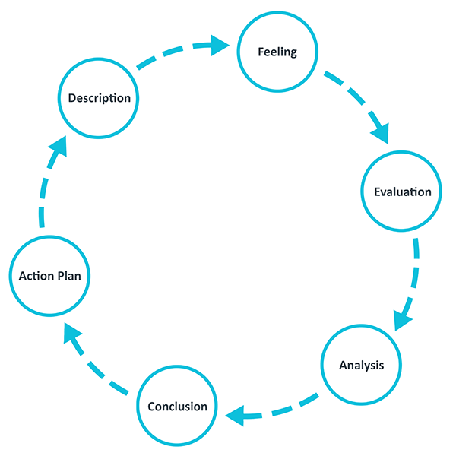
Gibbs' Reflective Cycle
Gibbs' Reflective Cycle was developed by Graham Gibbs in 1988 to give structure to learning from experiences. It offers a framework for examining experiences, and given its cyclic nature lends itself particularly well to repeated experiences, allowing you to learn and plan from things that either went well or didn’t go well. It covers 6 stages:
Description of the experience
Feelings and thoughts about the experience
Evaluation of the experience, both good and bad
Analysis to make sense of the situation
Conclusion about what you learned and what you could have done differently
Action plan for how you would deal with similar situations in the future, or general changes you might find appropriate.

Slide 23
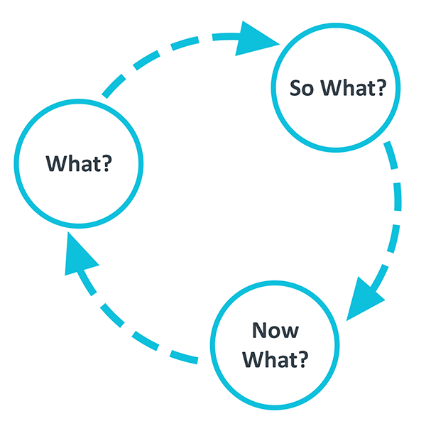
What? So what? Now what?
Driscoll (1994) developed this model of reflection based on the three simple questions – What? So what? Now what? – originally asked by Terry Borton (1970). The model provides one of the simplest frameworks for reflection. In practice you should ask yourself the three questions after a critical incident that has taken place and you want to extract learning from.
'What?' helps you describe the situation you want to learn from. You should identify the facts and feelings of the situation.
'So What?' allows you to extract the meaning of 'What?'. Moreover, you should question what knowledge you and others had in the situation, and what knowledge or theories that could help you make sense of the situation.
'Now what?' allows you to create an action plan for the future based on the previous questions.

Slide 24
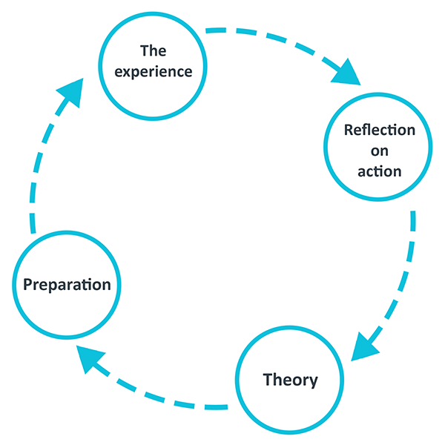
The Integrated Reflective Cycle
The Integrated Reflective Cycle (Bassot, 2013) is a model of reflection that will guide you through four steps to make sense of and learn from an experience. The model will allow you to explore feelings, assumptions and your own professional practice.
The Experience: Describe the experience
Reflection on Action: Look at the experience and identify what went well and what could be improved. It is here you explore your thoughts, feelings, and assumptions and ask yourself why.
Theory: Think about the experience in larger context of professional literature and your own learning and personal experience.
Preparation: Using your reflection to prepare yourself for future experiences.

Slide 25
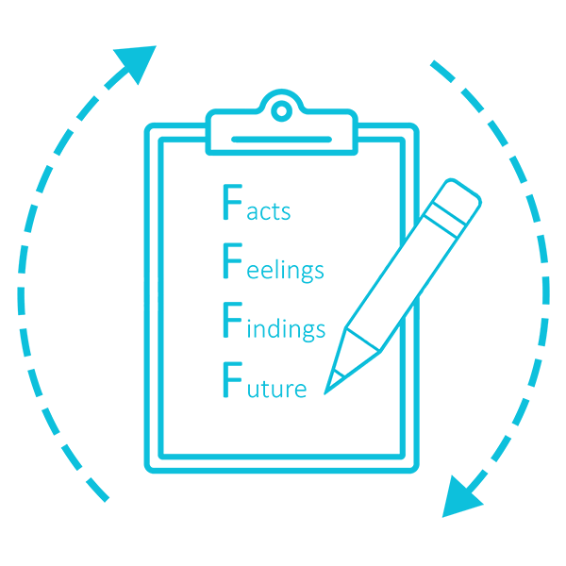
The four F's of active reviewing
This framework is designed by Dr Roger Greenaway, an expert on training teachers and facilitators. By working through the four levels of this model, you will have critically examined the situation you want to review and reflect upon, while thinking about how to use what you have learned in the future.
The four F’s are:
Facts: An objective account of what happened
Feelings: The emotional reactions to the situation
Findings: The concrete learning that you can take away from the situation
Future: Structuring your learning such that you can use it in the future

Slide 26
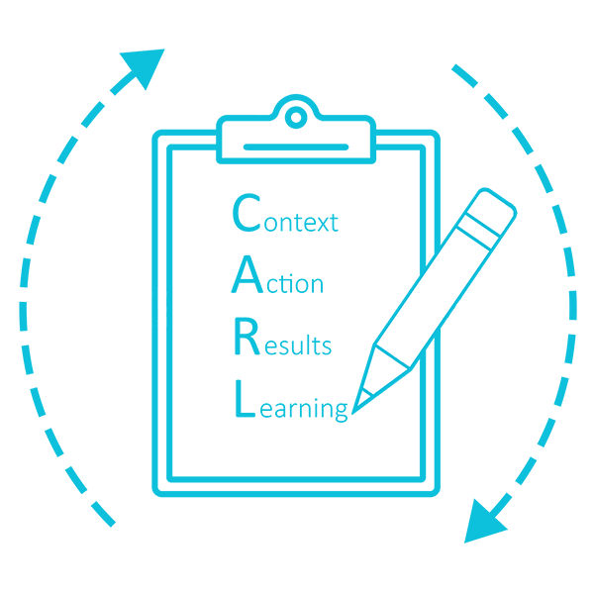
The CARL framework of reflection
The CARL model is adapted from a job interview technique where you structure each of your answers according to the different aspect of the model. Given the reflective nature of successfully answering many job interview questions, this model can easily be used in general to guide your reflective process on experiences. CARL stands for:
Context: Briefly describe the context of you experience
Action: Explain what actions you took
Results: Explain what happened as a result of your actions
Learning: Identify what you have learned

Slide 27
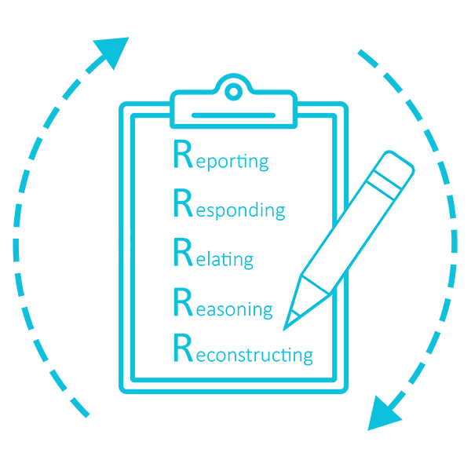
The 5R framework for reflection
This framework developed by Bain et al. (for example 2002), focuses on five core stages, each addressing one aspect of reflection. By thinking about all 5 stages individually you will engage with all the essential components of reflection, enabling you to produce a critically engaged reflection based in your experience. This model can also be helpful for structuring reflective writing.
The 5 stages are:
Reporting of the context of the experience
Responding to the experience (observations, feelings, thoughts, etc.)
Relating the experience to knowledge and skills you already have
Reasoning about the significant factors/theory to explain the experience
Reconstructing your practice by planning future actions for a similar experience

Slide 28
Benefits of Critical Reflection
Some of the benefits of engaging in critical reflection include:
Strengthening professional practice.
Generating learning.
Engaging higher order thinking and creative practice.
Helping educators make sense of experience.
A vehicle for problem solving.
Allowing the development of deeper understandings.

Slide 29
Cognitive Learning

Slide 30
What is Cognitive Learning?
Cognitive learning is an active style of learning that focuses on helping you learn how to maximize your brain’s potential. It makes it easier for you to connect new information with existing ideas hence deepening your memory and retention capacity.
The ability of the brain’s mental processes to absorb and retain information through experience, senses, and thought is known as cognition.
Employers need to expose employees to training on cognitive learning—an organization whose employees have strong cognitive skills is likely successful.
Well-trained and fully engaged employees are capable of learning quickly and being highly productive by handling multiple complex tasks without the necessity of a supervisor.

Slide 31
Components of Cognitive Learning
Traditional learning mainly focuses on memorization instead of trying to achieve mastery in a particular subject.
The following are fundamental aspects of cognitive learning:
1. Comprehension- For cognitive learning to be efficient and benefit you, understand the reason why you are learning a specific subject in the first place.
2. Memory- Cognitive learning discourages cramming of information, which is very ineffective in education. Having a deep understanding of a subject improves your ability to relate new knowledge with previous experiences or information.
3. Application- Cognitive learning strategies help you apply new information or skills in life situations. They encourage you as you continue to develop problem-solving skills.

Slide 32
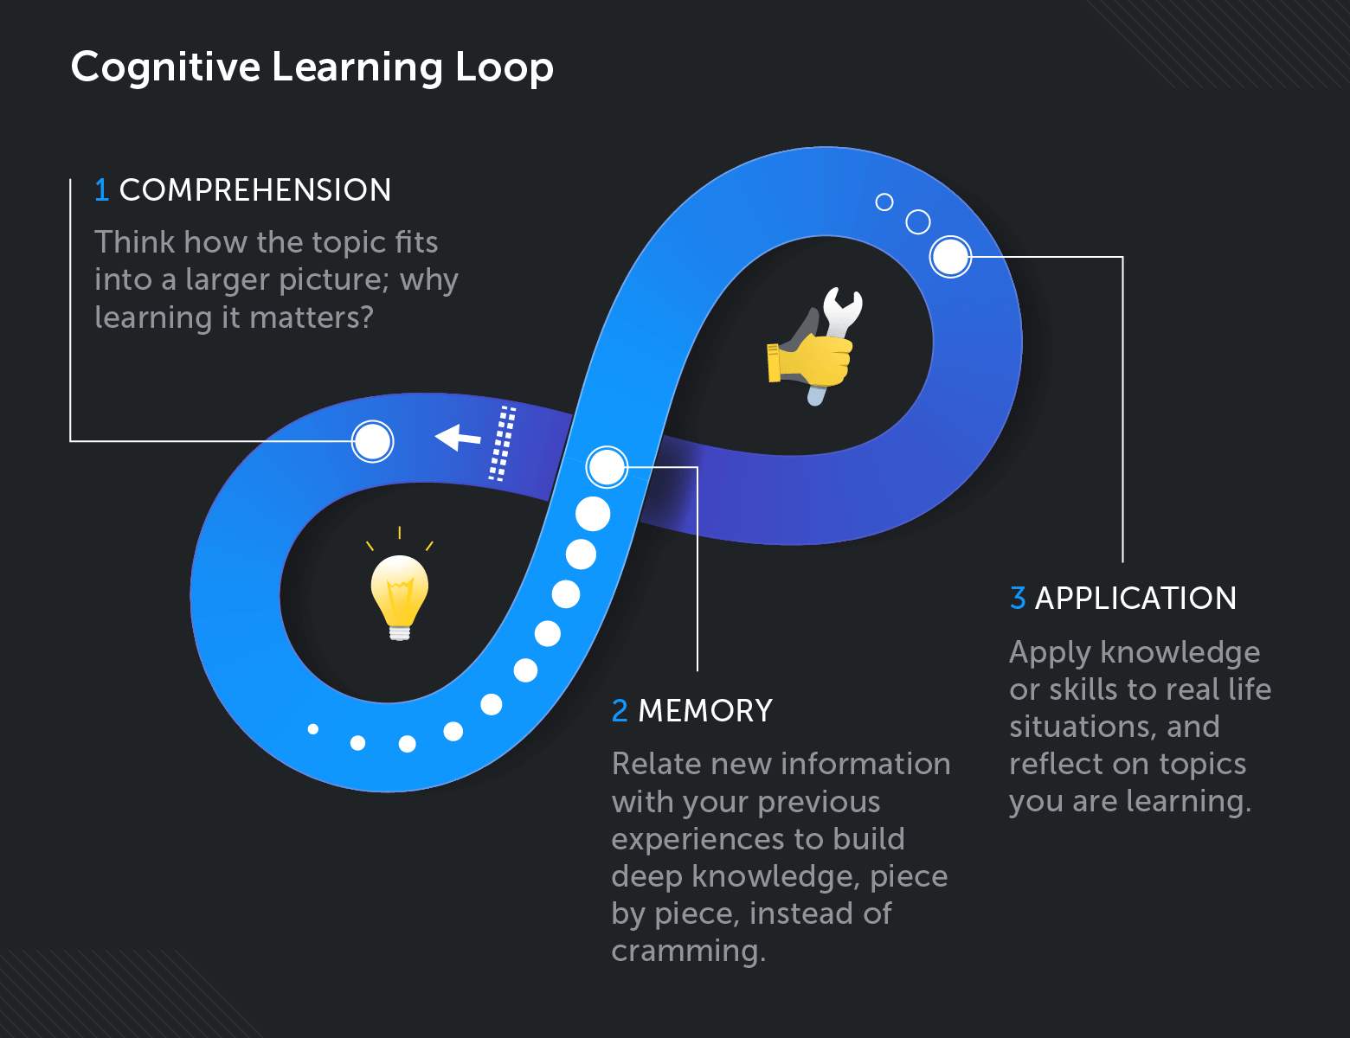

Slide 33
Сognitive Learning Theories
Cognitive learning theory explains how internal and external factors influence an individual’s mental processes to supplement learning.
Delays and difficulties in learning are seen when cognitive processes are not working regularly. These processes are such as attention, observation, retrieval from long-term memory, and categorization.
Today, cognitive learning theory is dominant in psychology. It is broken down into two categories.
Social Cognitive Theory
Cognitive Behaviorial Theory

Slide 34
Сognitive Learning Theories
Social Cognitive Theory
This theory helps us understand how people are influenced and their influence on the environment.
One of the major components of social cognitive theory is observational learning. It is the process of learning others’ desirable and undesirable behaviors through observation.
It is a quick way of acquiring information when you individually take action. A person who demonstrates behavior for another person is known as a model.
These may be real people such as teachers, our peers, and supervisors, or symbolic models, also known as fictional characters that influence an observer’s behavior.
Observational learning teaches people both positive and negative behaviors. For example, a manager within a company can teach the employees how they are supposed to behave ethically and be socially conscious when interacting and dealing with rude customers. Moreover, the manager can also train his/her employees on the different procedures that they can take in case of fire or other low probability hazardous scenarios.

Slide 35
Сognitive Learning Theories
Cognitive Behavioral Theory
This theory mainly refers to our mental processes, such as our thoughts and interpretations of life events.
It explains how the thoughts, feelings, and behavior of a person interact with each other. Thoughts lead to particular emotions, which in turn lead to specific behavioral responses.
When we change our thoughts, we can change our emotions and then our behaviors. It also works in reverse where changing how we behave leads to changes in our feelings and, ultimately, our thoughts.
Let’s take an example of a developer who encounters a problem in a particular sphere and automatically believes that the task is difficult for him/her right away. The employee is automatically likely to have a negative attitude towards this particular task, and his performance will likely be poor.

Slide 36
Benefits of Cognitive Learning
1. Enhances learning- Cognitive learning theory enhances lifelong learning. Workers can build upon previous ideas and apply new concepts to already existing knowledge.
2. Boosts confidence- Employees become more confident in approaching tasks as they get a deeper understanding of new topics and learn new skills.
3. Enhances Comprehension- Cognitive learning improves learners’ comprehension of acquiring new information. They can develop a deeper understanding of new learning materials.
4. Improves problem-solving skills- Cognitive learning equips employees with the skills they need to learn effectively. They are thereby able to develop problem-solving skills they can apply under challenging tasks.
5. Help learn new things faster- Through the experience of learning, the employee will be able to recycle and use the same learning methods that worked previously. This will help them learn new things a lot faster as they already know what works for them when it comes to obtaining new knowledge.
6. Teaches to form concept formation (think abstract)- Cognitive learning can also teach your employees to form a range of different concepts such as easily perceiving and interpreting information that could boost creativity and lead to innovations at the workplace.

Slide 37
Cognitive Learning Strategies
Learner-centered strategy
According to this theory, learning begins with the accumulation of some basic knowledge and advancing deeper into the field with time.
Three vital components of learning:
Accommodation – taking new information into account by modifying what we already know.
Assimilation – the arrangement of new knowledge inside our heads beside what we know.
Equilibration – balancing what we already know with the new information that we are trying to acquire.

Slide 38
Cognitive Learning Strategies
Meaningful Experiences strategy
According to this theory, material that was closely related to what the learner knew was meaningful and always turned out to be effective.
Learners with relevant background knowledge find it easier to add new information.
During the training of learners in an organization:
There should be an emphasis on the meaningfulness of each session to the task at hand.
Background information on new material is essential.
New information should be instilled in learners in a sequence to build on what is already understood.

Slide 39
Cognitive Learning Strategies
Learning Through Discovery strategy
This theory identified three stages of cognitive representation which are enactive, iconic, and symbolic. Enactive defining the representation of knowledge through actions, iconic being the visual summarization of images, and symbolic which is the use of words and symbols to describe experiences.
His interpretation of Cognitive Learning Theory in a corporate environment can be put by:
Allowing employees to learn new skills and get new knowledge through new tasks and challenges.
Challenging trainees to solve real-world problems your organization faces.

Slide 40
Cognitive Learning Strategies
Personalized learning strategy
All of these strategies can be combined into one personalized learning approach. Each learner is unique and has their own experience, knowledge, and perception. Which can greatly influence the way they interpret and consume new information.
Creating learning experiences that fit each individual based on their own knowledge that is meaningful for their role which encourages them to discover new solutions can drive great results and improve their overall performance.
A common practice in recent years to create personalized learning is the use of modern technologies: AI recommendations, learning paths, machine learning, natural language processing.

Slide 41
Cognitive Learning Examples
1. Explicit Learning
It happens when you intentionally seek knowledge to attempt and learn a new skill or process that may be vital to your work. It requires you to be attentive and take action to acquire knowledge.
An example of explicit learning would be undertaking an in-depth video editing course to understand the functionality of the software in order to be able to use it appropriately for the needs of your work.
2. Implicit Learning
Sometimes you passively gain new knowledge and learn some new skills. It is known as implicit learning, where you are unaware of the entire process until you realize you have retained something new.
This type of learning may occur when you are working, talking, or going about your normal life.
Typing fast and without looking at your keyboard is one good example of implicit learning that comes automatically over time.

Slide 42
Cognitive Learning Examples
3. Meaningful Learning
Meaningful learning is when you are capable of acquiring new information and relating it to past experiences.
This is because this cognitive learning approach teaches employees to build transferable problem-solving skills that can be applied in other areas.
An example of meaningful learning is when you work in procurement and decide to take an advanced course in your department to deepen your understanding of the subject.
4. Discovery Learning
It happens when you actively seek new knowledge by researching new concepts, processes, and subjects.
For example, if someone is set the task to proofread a particular report and they need to make use of a specific tool such as Grammarly, by using this tool in hand with the manuals, this would cause them to learn the features and abilities of the tool through discovery.

Slide 43
Cognitive Learning Examples
5. Receptive Learning
Lectures where you sit in groups and a speaker feeds the audience with information on a specific subject is an example of receptive learning. It requires the learner to be active by asking questions and taking down short notes.
During training in your workplace, this type of learning comes in handy where you get a deeper understanding of new information by being active and responsive to the speaker.
6. Non-Associative Learning (Habituation and Sensitization)
It is a type of learning that enables humans to adapt to something by facing it frequently.
When you get a new job at a factory where there are many machines making noise, it irritates for the first few days, but you later learn how to live with it. This is known as habituation.
Sensitization is the vice versa whereby your reaction towards something increases as you get frequent exposure towards it.
This type of learning happens in your typical situations in life and work. Working in an office teaches you to be more responsive to things like telephone calls.

Slide 44
Cognitive Learning Examples
7. Emotional Learning
Developing emotional intelligence is crucial to help us maintain friendly relationships with friends at work and in life.
Emotional learning helps people learn how to take charge of their emotions and also understand others’.
An employer requires to have control over their emotions so as to handle customers and also their superiors in a courteous manner.
8. Experiential Learning
Our experiences in life are our best lessons.
Your interactions with other people always teach you some precious life lessons. What you learn depends on how you interpret it.
For example, an intern learns by shadowing an experienced senior employer to gain experience. He acquires new skills that are relevant to his line of work.

Slide 45
Cognitive Learning Examples
9. Observation Learning
One of the significant components of the social cognitive theory is observational learning.
It is handy among employees since it mainly involves imitation of skills from colleagues and superiors.
Observing your friends or work colleagues is an efficient way to learn a new skill.
Your successful manager at work can help you improve your leadership qualities as you embrace and practice his habits.
10. Cooperative and Collaborative Learning
Working and learning in groups is encouraged in many institutions.
Cooperative learning helps bring out one’s best skills and deepens the collaboration between a group of people (read more about collaborative learning).
However, for an individual to learn this way, he/she has to be an active and equal participant and interact with fellow group members.

Slide 46
Teamwork and Collaboration: How To Improve Both

Slide 47
Introduction
Combined, teamwork and collaboration can foster a healthy work culture and environment where teams of individuals can achieve goals through powerful skills and effective work. Collaborative teamwork can promote innovation, increase job satisfaction, find solutions to resolve problems and develop excellent soft skills.

Slide 48
What is collaboration?
Collaboration is the action of working with one or more people who have different skill sets to produce something, such as finishing a project, developing a shared idea or completing a task.
In business, collaboration refers to colleagues with varying areas of expertise working together on a common goal to accomplish a purpose or produce results.
Workplace collaboration is a set of learned skills that can improve productivity, solve problems, foster healthy relationships and create teamwork.

Slide 49
Examples of collaborative skills
Self-awareness: Be clear about who you are, what you want and what you need from others.
Purpose-driven: Keep in mind the purpose of the project and its goals.
Resource management: Keep information organized and know how to share it.
Forgiveness: Be willing to apologize for mistakes and forgive those who make errors.
Collaboration tools: Communicate clearly and in a timely matter using collaborative tools.
Address problems: Be willing to find and discuss obstacles with an open mind.
Learning opportunities: Create team experiences to engage in learning, foster growth and be creative.
Soft skills: Build your mindset and character as it affects how you handle projects.
Encourage innovation: Face obstacles and overcome challenges with a positive attitude.
Share success: Expand your idea of success to include achieving big group goals and team wins.

Slide 50
What is teamwork?
Teamwork is the qualities, abilities and processes of working well with one or more people to accomplish a common goal.
Teamwork in the workplace is a group's ability to work together effectively, communicate well, define roles and leadership, share resources and actively listen to each other.
Teamwork is a set of learned skills that can boost morale in the workplace, build rapport, increase the quality and quantity of output and improve retention rates.

Slide 51
Examples of teamwork skills
Interpersonal skills: Know how to interact and speak with others.
Conflict management: Help mediate between members and settle your own disputes fairly.
Communication: Be open to constructive criticism and sharing your ideas with others.
Listening: By actively listening, your teammates feel valued and you reduce miscommunications.
Enthusiasm: Have a positive outlook and be excited about working together.
Time management: Have good time-management skills as it can affect your team project.
Respectfulness: Make eye contact and listen actively.
Positivity: Be positive and help others to be positive, too.
Reliability: Complete your tasks, be mindful of deadlines and let other know they can count on you.

Slide 52
What is collaborative teamwork?
When you combine collaboration and teamwork, you get a team whose members have distinct skill sets and have the ability to productively work together. There is both individuality and a cohesive group. Each individual knows how to use their role, skills and expertise while also working as one with the entire group to accomplish a goal.
Collaborative teamwork engages the group to combine expertise and problem-solve together, while also assigning individual tasks and roles for autonomy. This type of group work is an intentional coordination of how and when participants act to achieve efficiency.

Slide 53
Benefits of teamwork and collaboration
Increases productivity and efficiency: Collaboration allows individuals to focus on what they do best so that the entire team benefits. Each person has their own strengths and specialties that they bring to the team, creating efficiency and productivity.
Enhances social skills and communication: Individuals on a team grow social skills and communication by learning to relate to peers, improving decision-making skills, presenting results and strategies, sharing their knowledge and developing communication skills.
Common goals: An environment of teamwork and collaboration acknowledges that employees can achieve success not only individually but through collaborative effort. These outcomes are often greater than what individuals can achieve by working independently.
Individual style: Teamwork provides the opportunity for employees to gain insight into their style, such as discovering whether they focus on the positive or the negative or whether they're reactive or proactive.
Increases diversity: Working together with different people and personalities, especially from different departments within a company, lets employees learn from each other and about other aspects of the business.
Enables learning: Informal learning naturally occurs when individuals take part in collaboration and teamwork, particularly when there is a safe environment that encourages learning from mistakes, friendly competition, debrief sessions and open conversations.

Slide 54
How to improve teamwork and collaboration
Establish intentional leadership. This type of leadership creates an environment for easy collaboration and purposefully considers and implements factors for good teamwork.
Make change a positive step. Learn to embrace change positively and let go of the fear of the unknown. This includes learning to accept failures and criticism with a positive attitude.
Clarify roles. Each team member needs clarification on their role in the group, their individual and group responsibilities and the group's expectations for them.
Create group problem-solving. Bring your team together by encouraging open dialogue and productive problem-solving strategies.
Take advantage of project management tools. There are a variety of online project management tools that can help track teams, organize projects, conceptualize ideas and improve communication. Try to find a program that works best for your team.
Let leadership change. Allow leadership roles to naturally shift and change as the project matures and different needs develop.

Slide 55
How to improve teamwork and collaboration
Celebrate individuality. Leaders should recognize individual efforts and understand that everyone works with different methods, styles and schedules.
Be a model of behavior. Instead of just talking about expectations, model for your team the integrity and accountability you want to see.
Stay curious. Help the team consider and explore outside viewpoints, look for overarching themes or ask questions about data.
Be humble. Show your humanity by being able to acknowledge when you're unsure of something. Asking for help is a natural part of collaboration and teamwork.
Create infrastructure. Prevent struggles when organizing a project by reviewing potential bottlenecks and creating open channels of communication.
Invite healthy debate. Turn discourse into a healthy debate with professional conduct and respectful communication.

